Slide 1


Exception Handling
Mentor – Mr.Kirubanantham C
By – Rishabh Dhing,
Ashwini Tiwari

Slide 2
What is Exception Handling?
Exception Handling is one of the effective means to handle runtime errors so that the regular flow of the application can be preserved. Exception Handling is a mechanism to handle runtime errors such as ClassNotFoundException, IOException, SQLException etc.

Slide 3
What is an exception?
Exception is an unwanted or unexpected event, which occurs during the execution of a program, i.e. at run time, that disrupts the normal flow of the program’s instructions. Exceptions can be caught and handled by the program .

Slide 4
Why Exception occurs?
Invalid user input
Device failure
Loss of network connection
Code errors
Opening an unavailable file

Slide 5
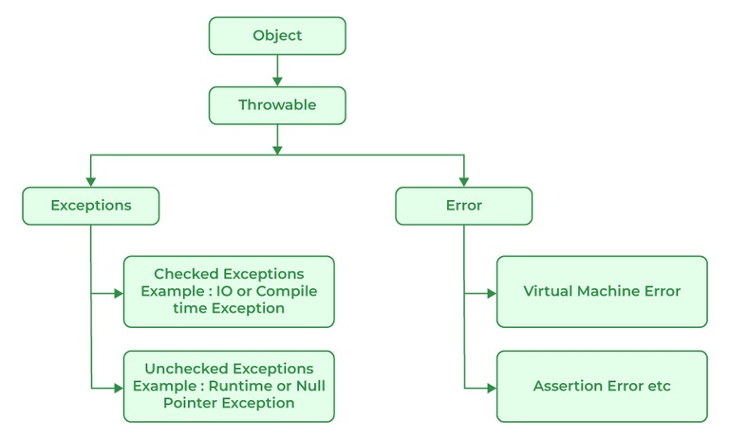
Exception Hierarchy

Slide 6
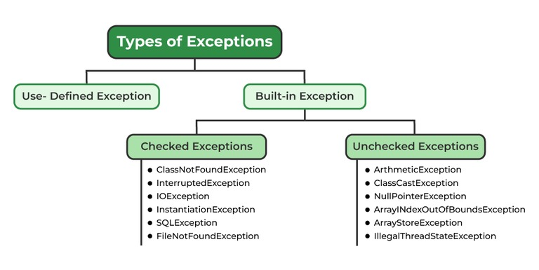
Types of Exception

Slide 7
Types of Exception
1.Built-In Exception - Built-in exceptions are the exceptions that are available in Java libraries. These exceptions are suitable to explain certain error situations.
Checked Exceptions: These are errors detected by the compiler during the compilation process.Examples include syntax errors, type mismatch errors, and missing semicolons in languages like Java, C++, and C#. Compile-time exceptions prevent the code from being compiled successfully. Example : SQLException , IOException , FileNotFoundException.
Unchecked Exceptions: These errors are detected during Runtime. Runtime exceptions occur during the execution of the program.These errors are not detected until the program is running.Examples include dividing by zero, accessing an array out of bounds, and null pointer dereference.Runtime exceptions can lead to program crashes if not handled properly

Slide 8
Types of Exception
2. User-Defined Exceptions:Sometimes, the built-in exceptions in Java are not able to describe a certain situation. In such cases, users can also create exceptions, which are called ‘user-defined Exceptions’.

Slide 9
Exception Handling Mechanisms
Try-Catch Blocks: A try block contains code that may throw an exception, and a catch block catches and handles the exception if it occurs.
Finally Block: The finally block is used to execute code that should always run, regardless of whether an exception is thrown or not. It's commonly used for cleanup tasks like closing files or releasing resources.
Throw Statement: The throw statement is used to manually throw an exception within a program.

Slide 10
Examples
Example 1: Compile-Time Exception (Missing Semicolon) // Compile-time exception: Missing semicolon
public class CompileTimeExceptionExample {
public static void main(String[] args) {
System.out.println("Hello, World!")
}
}
output : Error: ';' expected

Slide 11
Examples
Example 2: Runtime Exception (Division by Zero) // Runtime exception: Division by zero
public class RuntimeExceptionExample {
public static void main(String[] args) {
int a = 10; int b = 0;
int result = a / b; // This will throw ArithmeticException
System.out.println("Result: " + result);
}
}
Output: Exception in thread "main" java.lang.ArithmeticException: / by zero at RuntimeExceptionExample.main(RuntimeExceptionExample.java:6)

Slide 12
Example
Example 3: Try-Catch Blocks (Array Index Out of Bounds)
public class TryCatchExample {
public static void main(String[] args) {
try {
int[] numbers = {1, 2, 3};
System.out.println(numbers[3]); // Accessing out-of-bounds index
} catch (ArrayIndexOutOfBoundsException e) {
System.out.println("Array index out of bounds exception occurred!");
}
}
}
output : Array index out of bounds exception occurred!

Slide 13
Example
Custom Exception - Custom exceptions allow developers to define their own exception types to handle specific error conditions in their applications // Custom exception: InvalidAgeException
class InvalidAgeException extends Exception {
public InvalidAgeException(String message) {
super(message);
}
}
// Class that uses the custom exception
public class CustomExceptionExample {

Slide 14
// Method to validate age
public static void validateAge(int age) throws InvalidAgeException {
if (age < 18) {
throw new InvalidAgeException("Age must be 18 or older");
} else {
System.out.println("Valid age: " + age);
}
}
// Main method public static void main(String[] args)

Slide 15
{
try {
// Try to validate age
validateAge(17);
} catch (InvalidAgeException e) {
// Handle the custom exception
System.out.println("Exception: " + e.getMessage());
}
}
}
Output: Exception: Age must be 18 or older

Slide 16
THANKYOU

